Slide 1
Machine Learning Classification of Stock Performance
$
Byrnes Mulumbeni & Laura Tambwe Mwibashiye
DATA 3461 | Final Project

Slide 2
Motivation
The Challenge
Stock prediction is notoriously difficult
Even expert investors struggle to consistently beat the market
Traditional approaches rely on complex models with many data sources
Our Question: Can we predict stock performance using only fundamental accounting data and specific features?
Why It Matters
Fundamental analysis is the foundation of value investing
Understanding which financial metrics drive returns informs investment strategy
Machine learning can uncover nonlinear patterns humans miss

Slide 3

Research Questions
Can machine learning models accurately predict whether a US stock will increase in value in 2019 based on financial indicators from 2018?
Which financial indicators are the most influential in determining whether a stock’s price will rise the following year?
Which algorithm (Logistic Regression, Random Forest, Gradient Boosting) performs best for forecasting stock price movements?

Slide 4
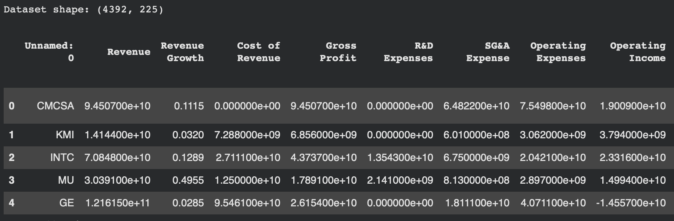
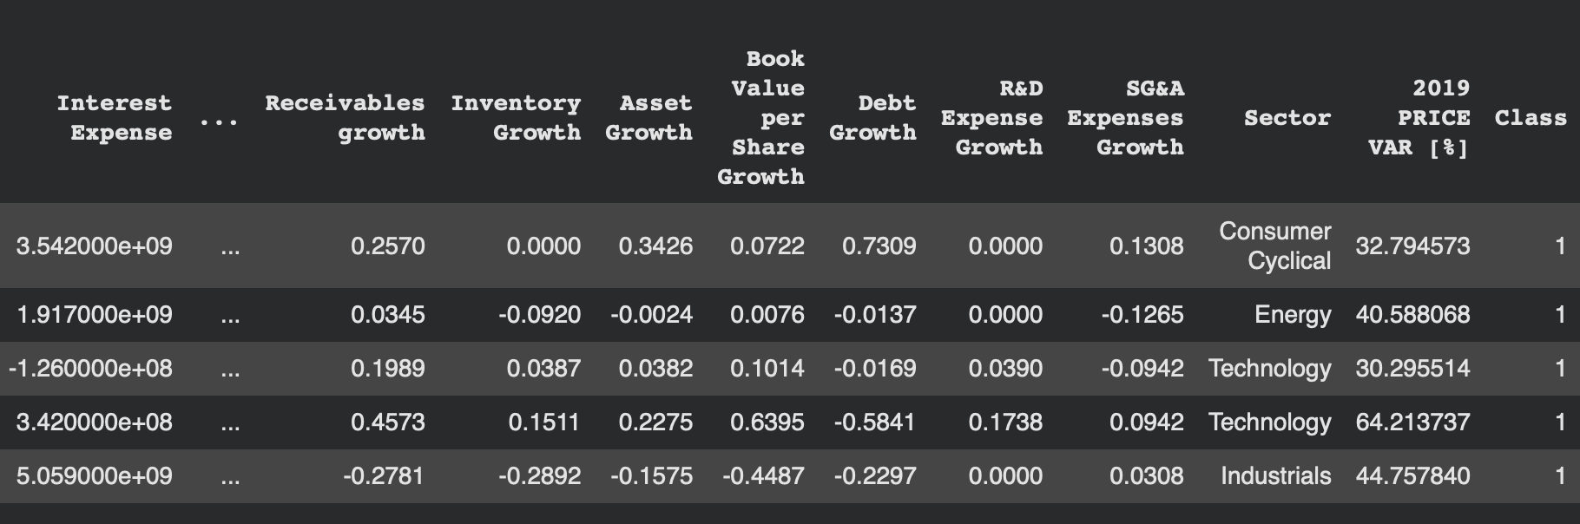
Data Overview
Source: Kaggle 200+ Financial Indicators of US stocks (2014-2018)
4,392 US companies
225 financial variables
Target:
Class 1: Price increased (610)
Class 0: Price decreased (269)

Slide 5
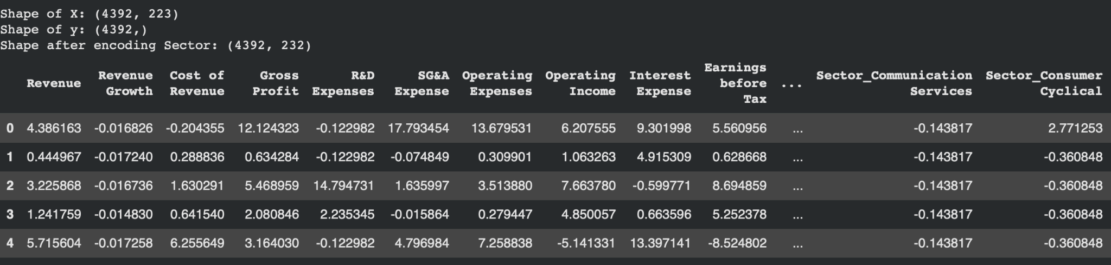
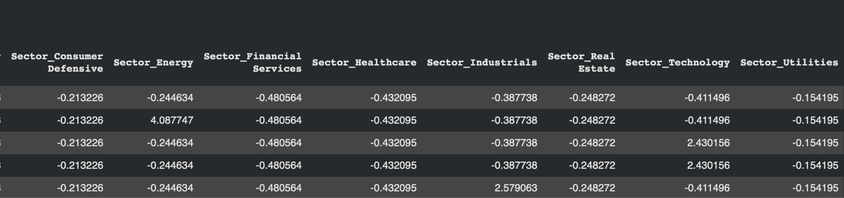
Preprocessing
Median imputation for missing values
One-hot encode Sector
Standardize features
Notes:
We used median imputation because it's robust to outliers, which are common in financial data

Slide 6
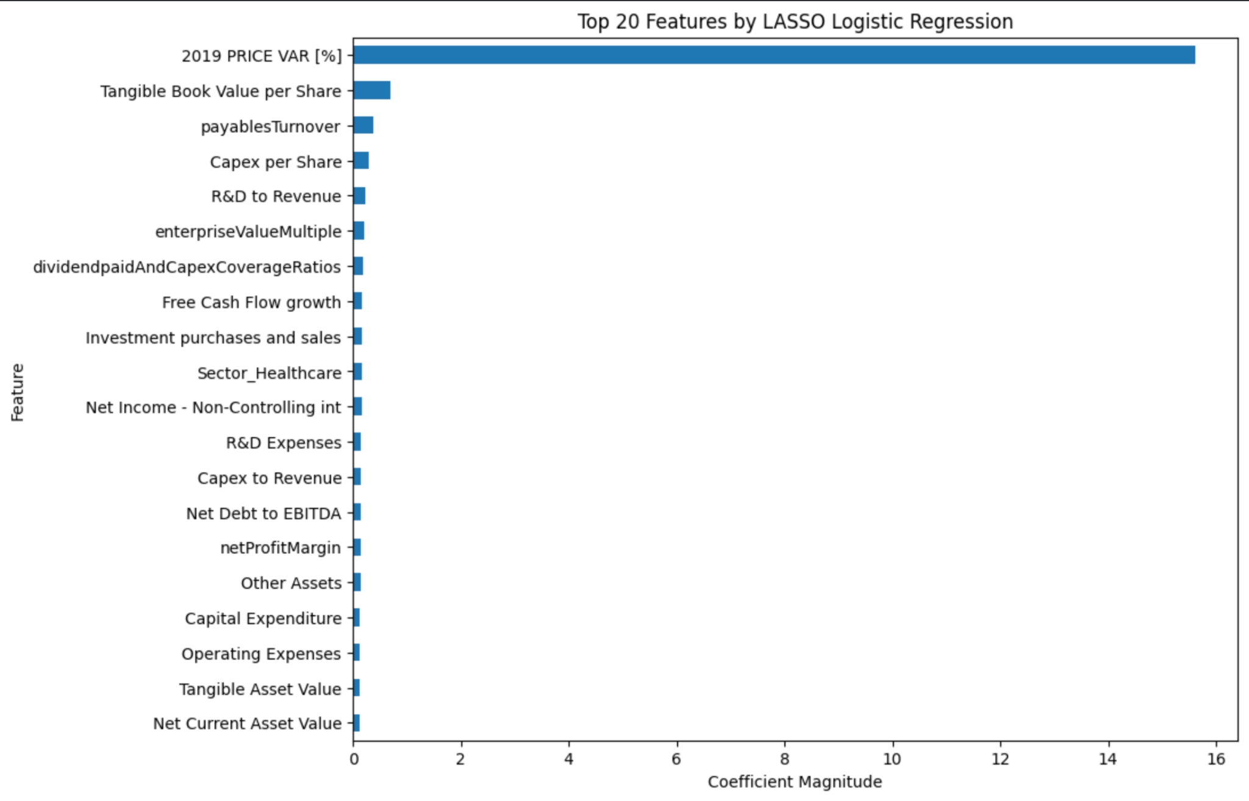
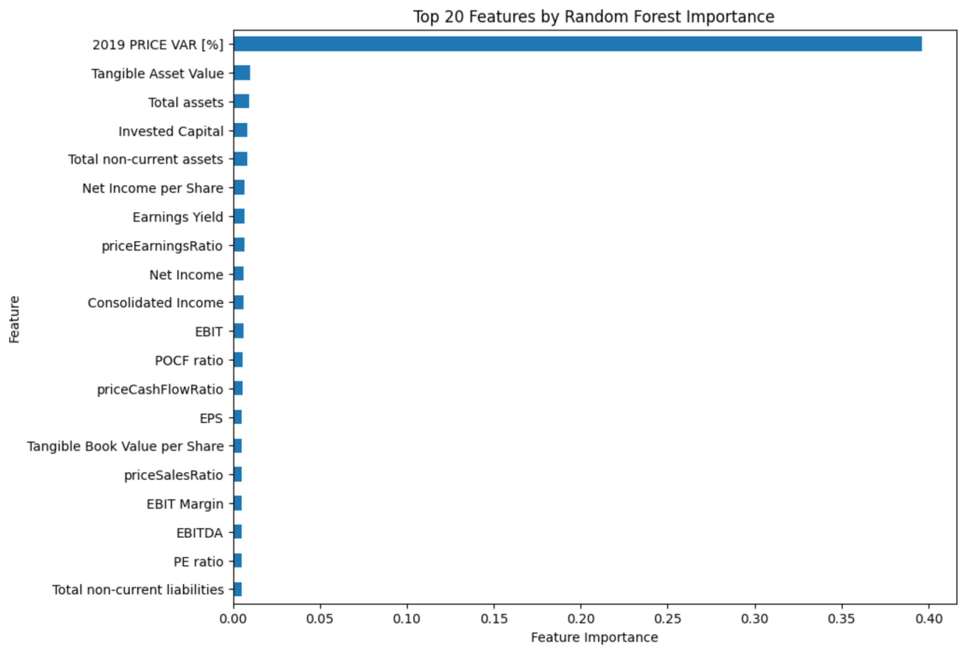
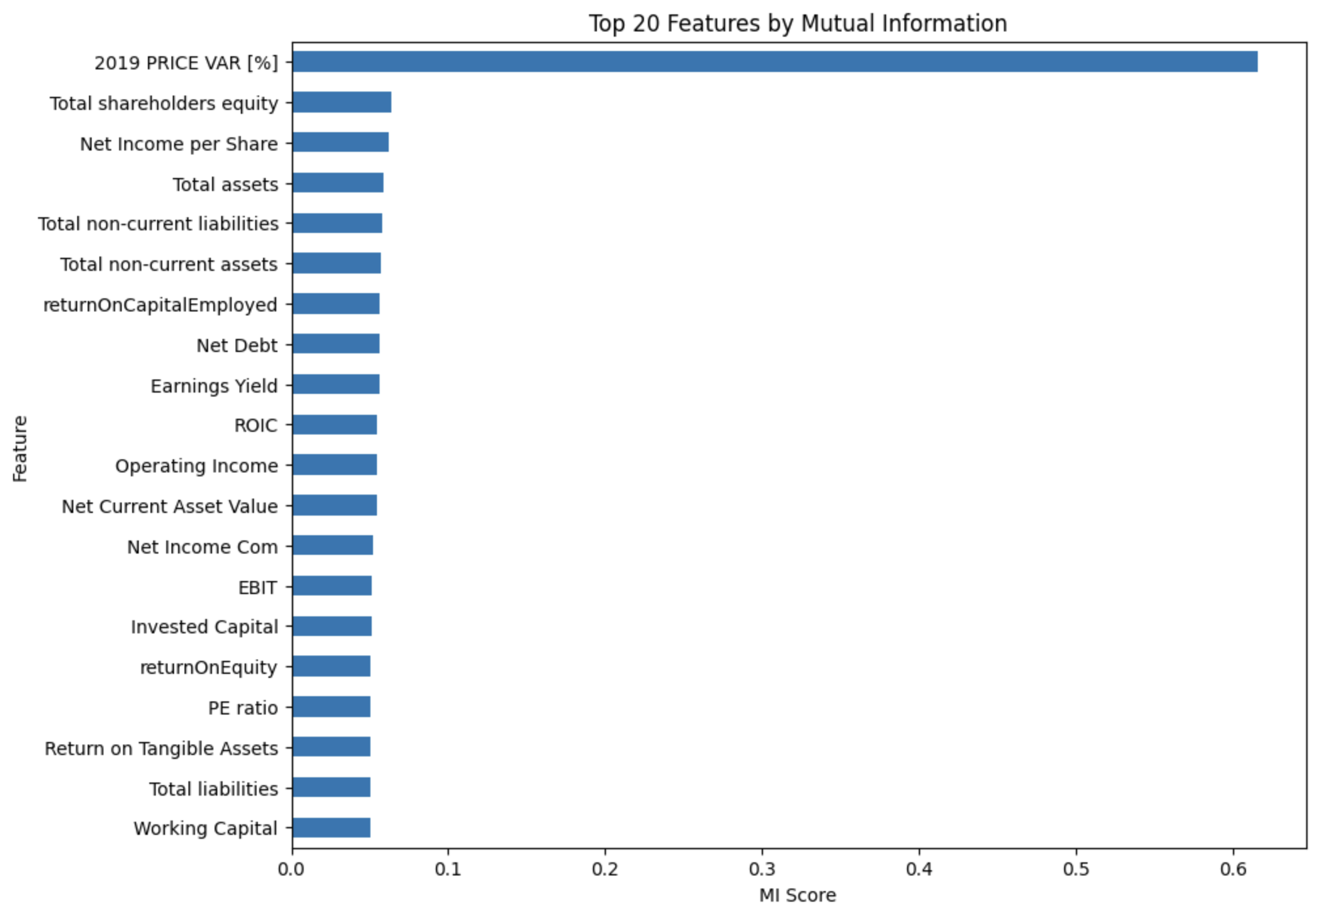
Feature Selection 1
Three methods:
Mutual Information
Random Forest Feature Importance
LASSO Regression
Notes:
Mutual Information: This measures how much knowing a feature reduces uncertainty about the target. It captures both linear and nonlinear relationships, which is important for financial data.
Random Forest Feature Importance: Random Forests rank features by how much they contribute to reducing impurity when making splits in the decision trees.
LASSO Logistic Regression: This uses L1 regularization, which automatically shrinks less important feature coefficients to zero. It's essentially doing feature selection as part of the model training process.

Slide 7
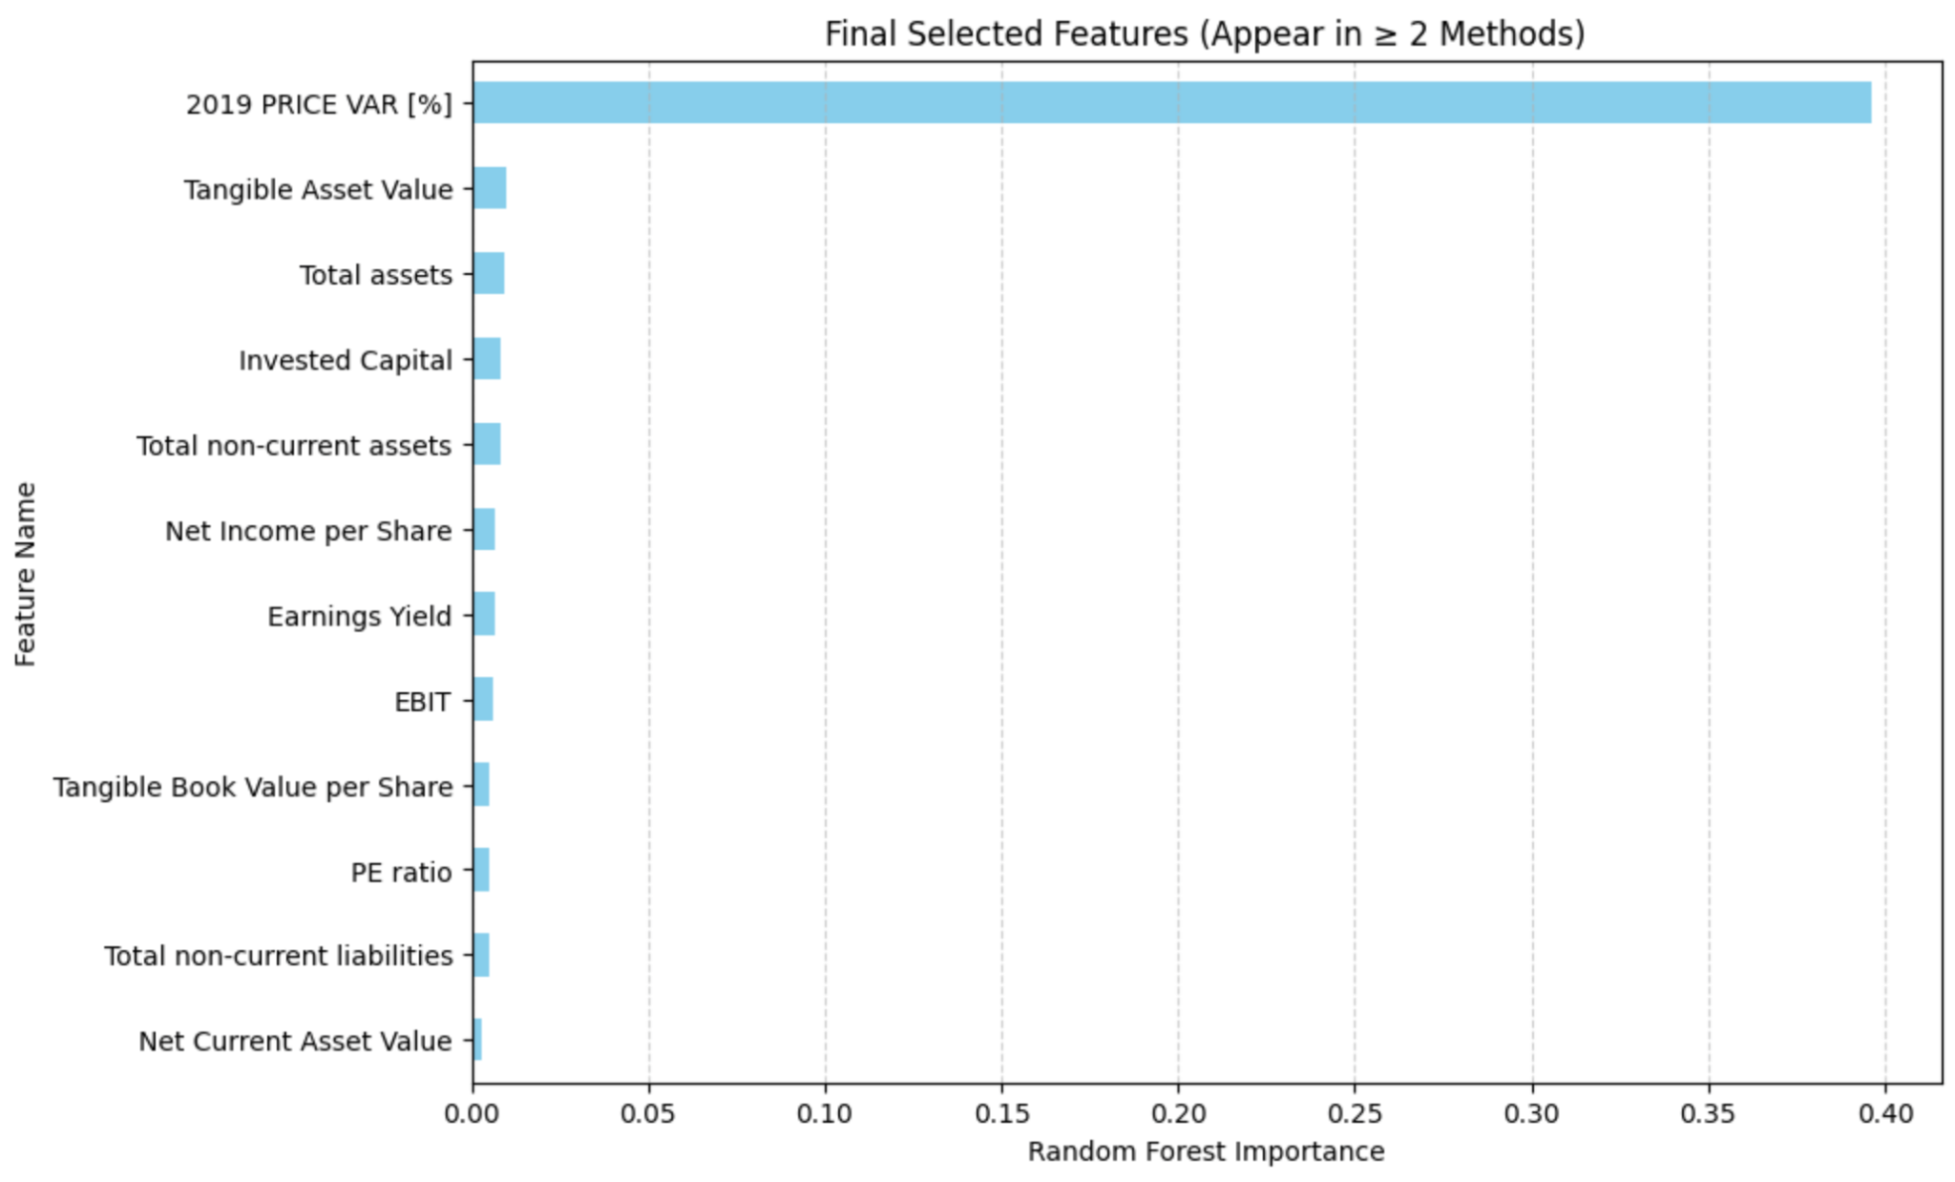
Feature Selection
Criteria: Feature must appear in ≥2 methods Result: 12 features selected

Slide 8
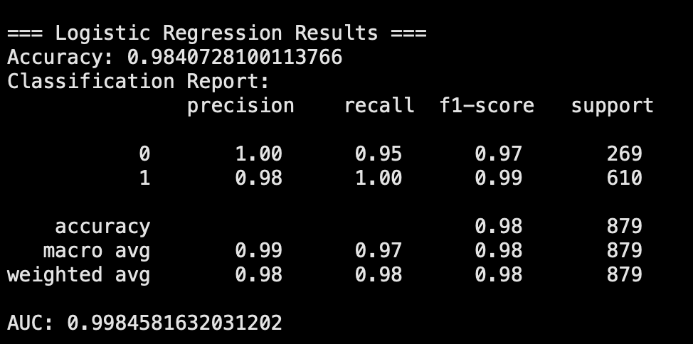
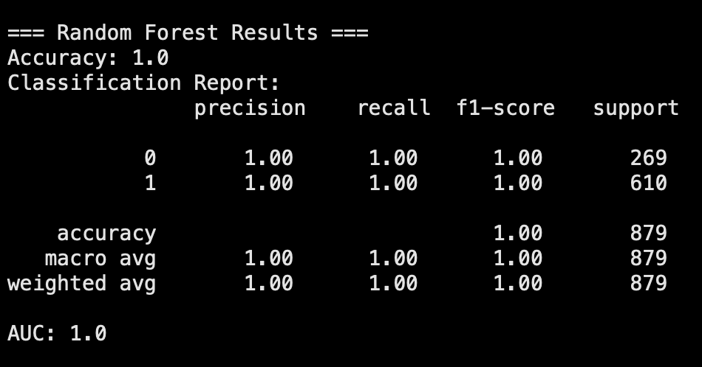
Problem Discovered: Data Leakage
The feature 2019 PRICE VAR [%] directly measures the stock's percentage price change in 2019. The target variable Class also depends on whether the stock increased in 2019.
Using this feature introduces data leakage, because the model has access to the future outcome it is supposed to predict.
This caused unrealistically high performance.
To correct this, we remove 2019 PRICE VAR [%] from the dataset and redo the feature selection and model training steps.
Notes:
When we trained our initial models using these 12 features, we got unrealistically high accuracy.
We dug into our selected features and discovered the problem: one of our 12 features was "2019 PRICE VAR [%]"—which directly measures the stock's price change in 2019, the exact thing we're trying to predict.
This is textbook data leakage. We essentially gave the model the answer key. Of course it got 99% accuracy - it was cheating!
So we removed that feature and redid our entire feature selection process. And as we'll see next, we actually had to do this again before we finally got it right.

Slide 9
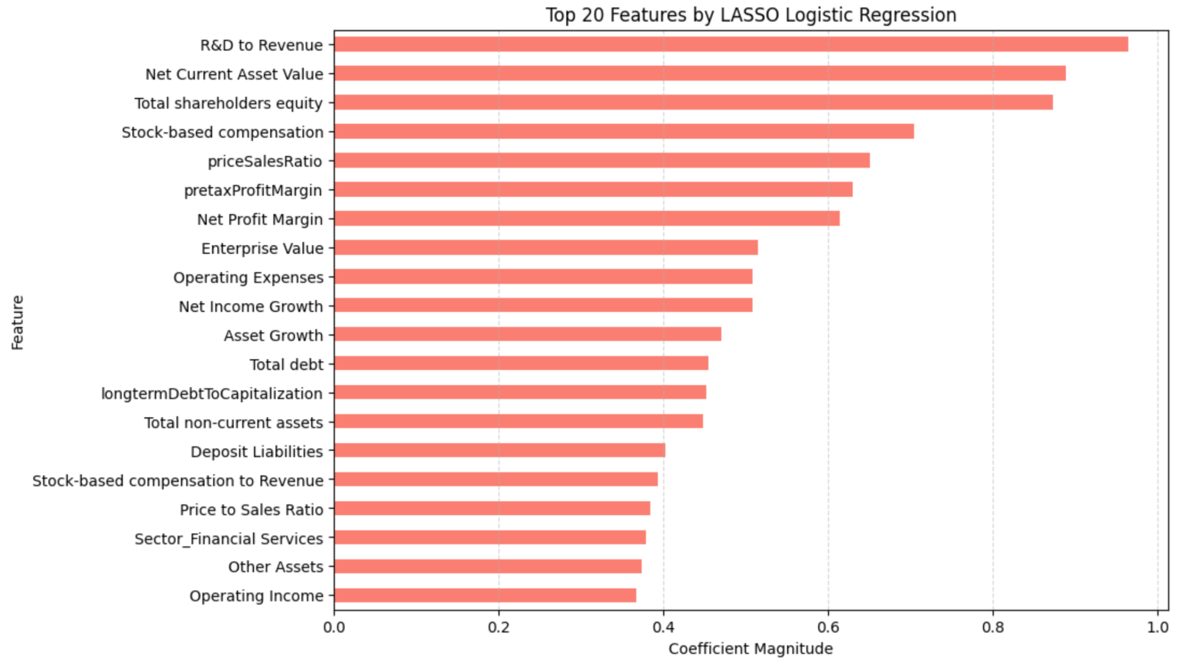
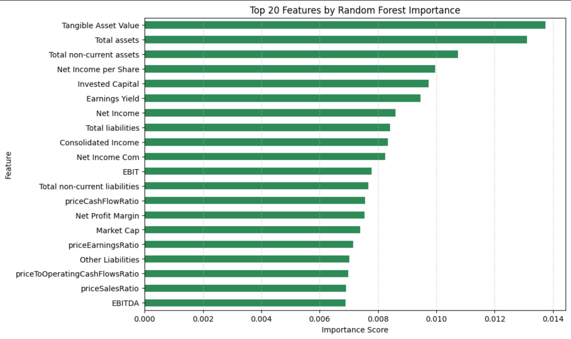
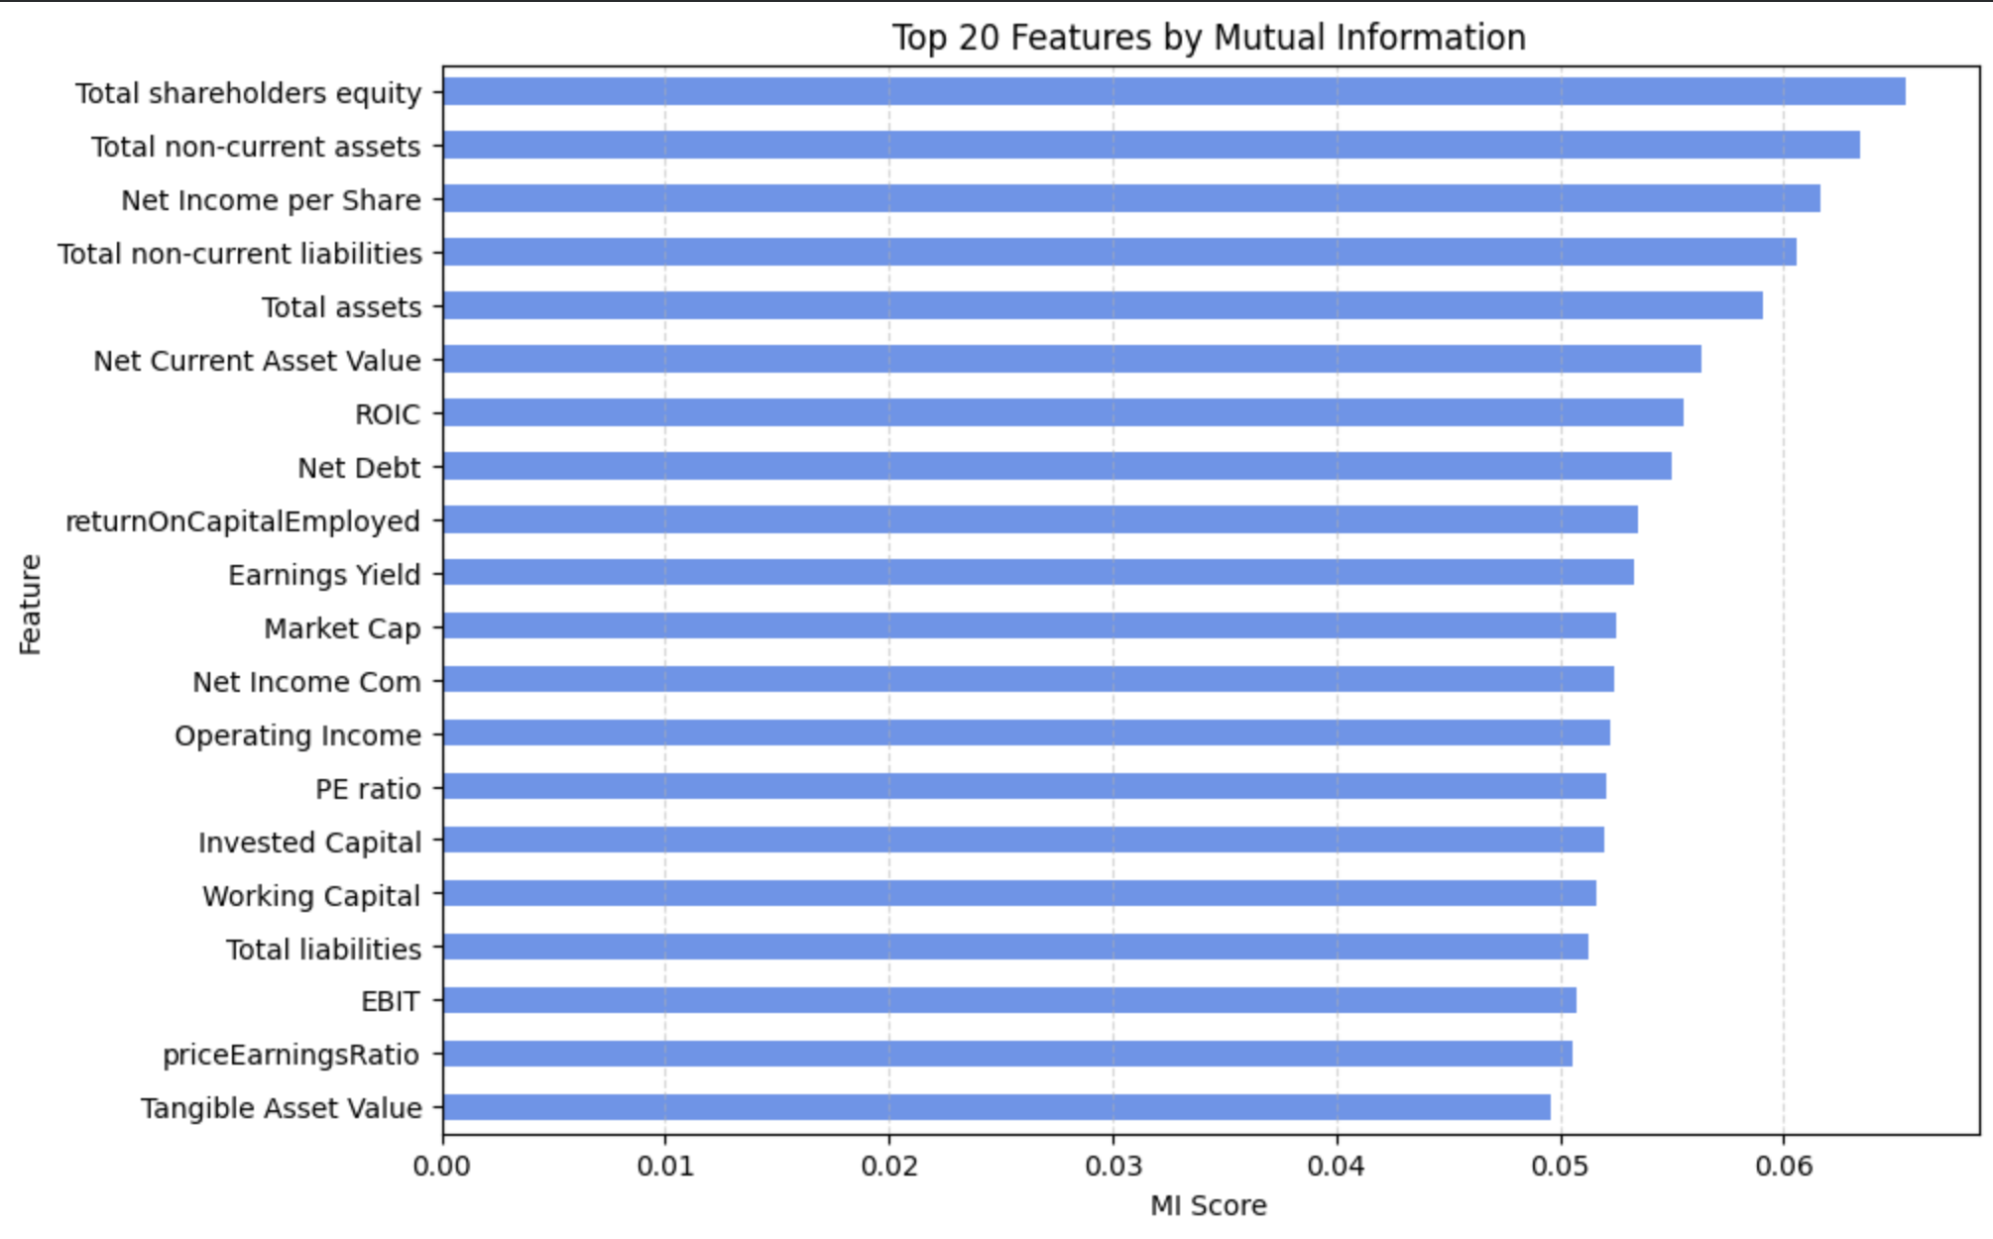
Feature Selection 2
Three methods:
Mutual Information
Random Forest
LASSO Regression

Slide 10
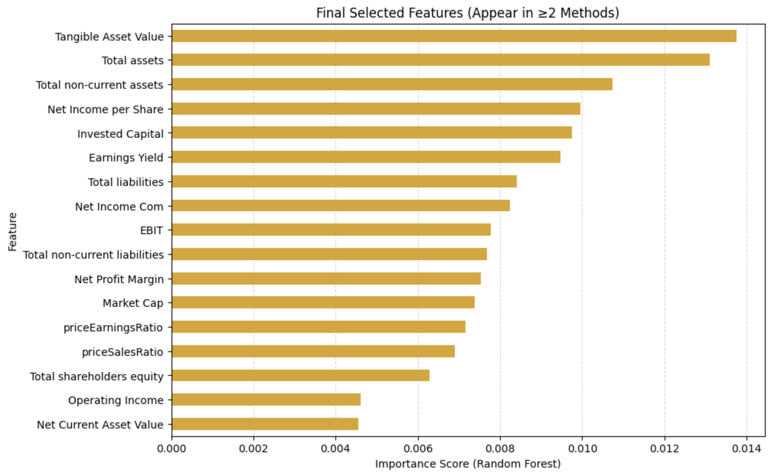
Feature Selection 2
Criteria: Feature must appear in ≥2 methods Result: 17 features selected

Slide 11
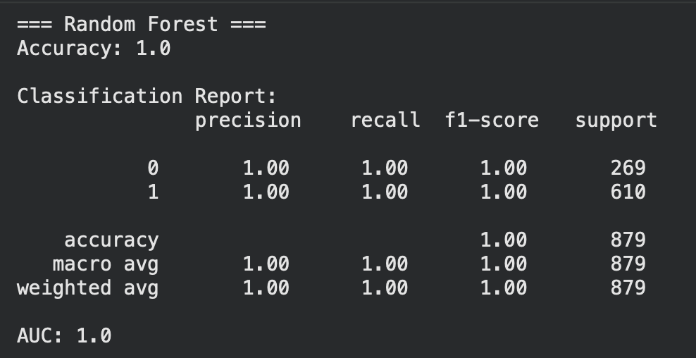
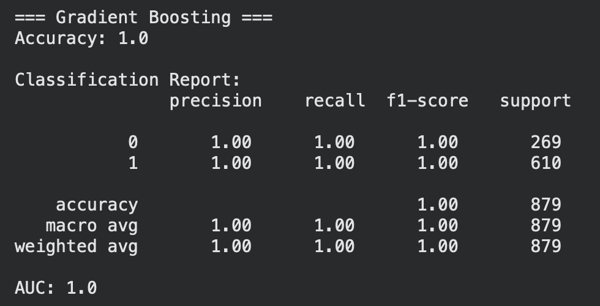
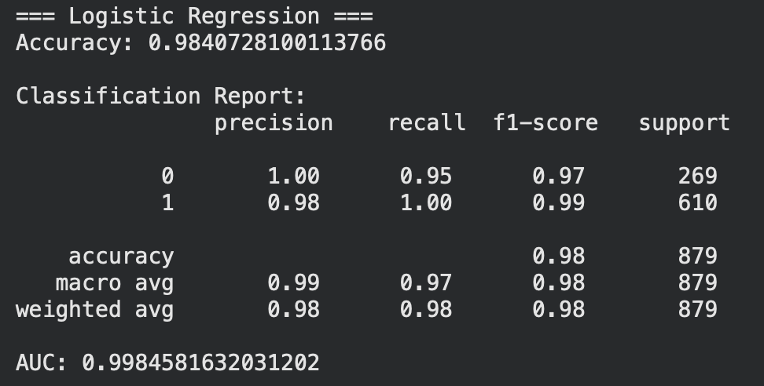
Data Leakage, Again

Slide 12
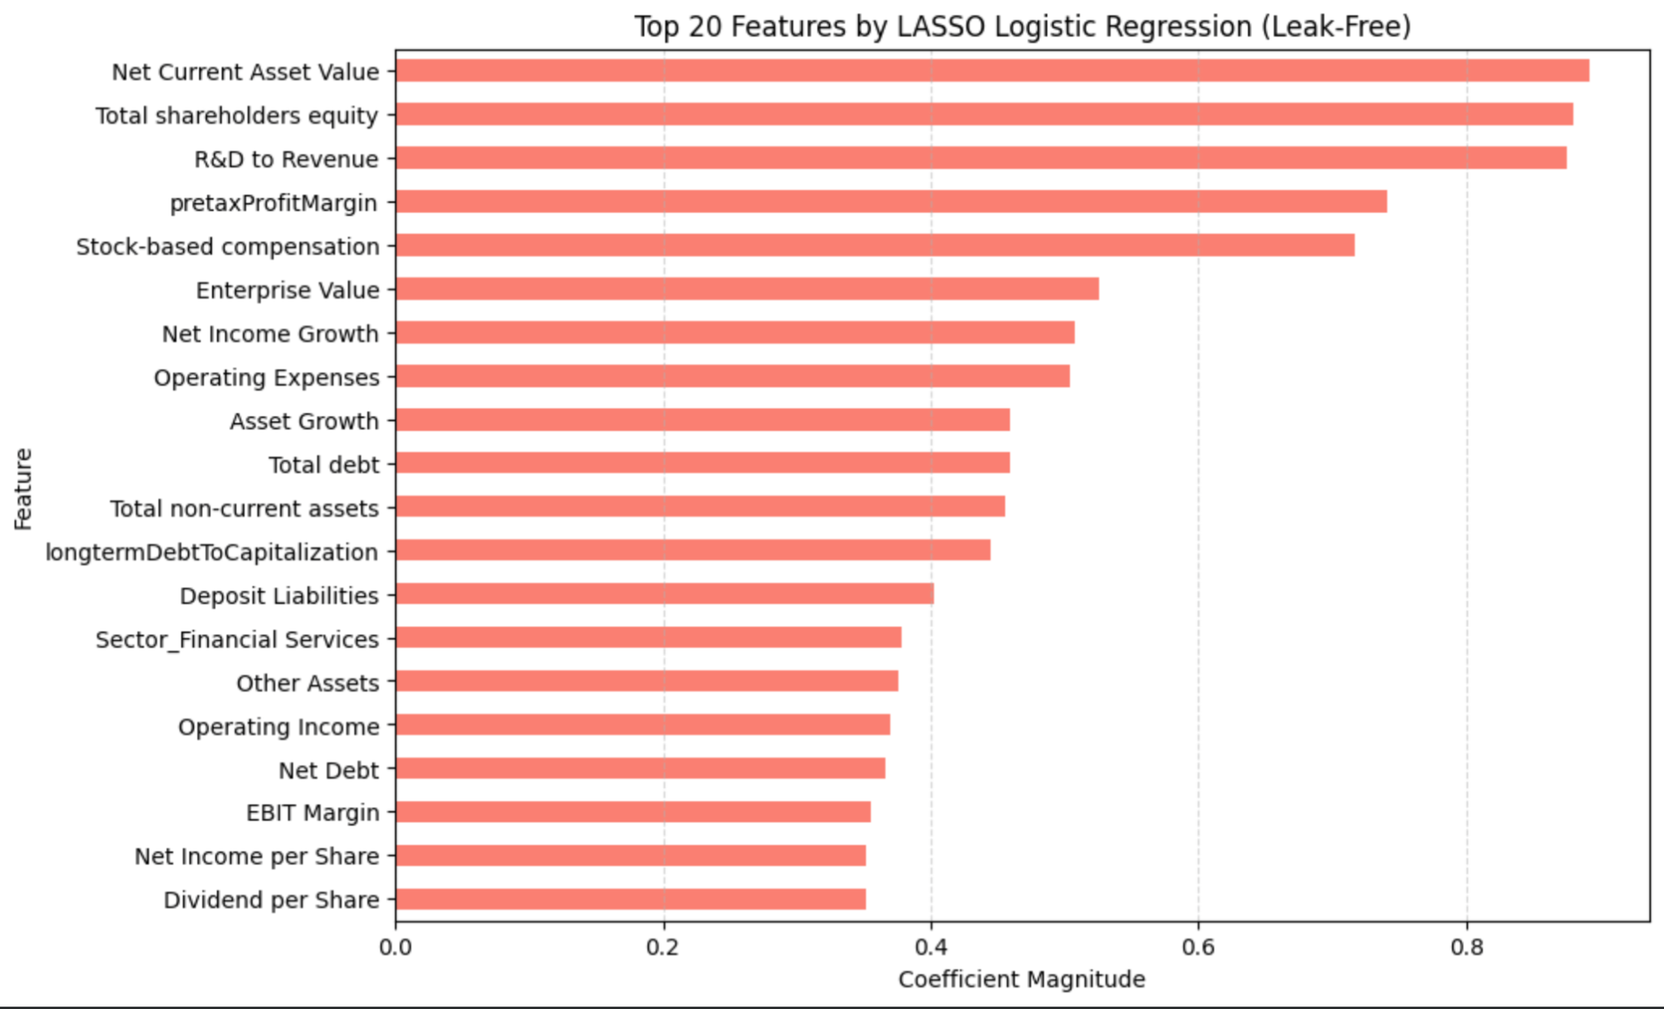
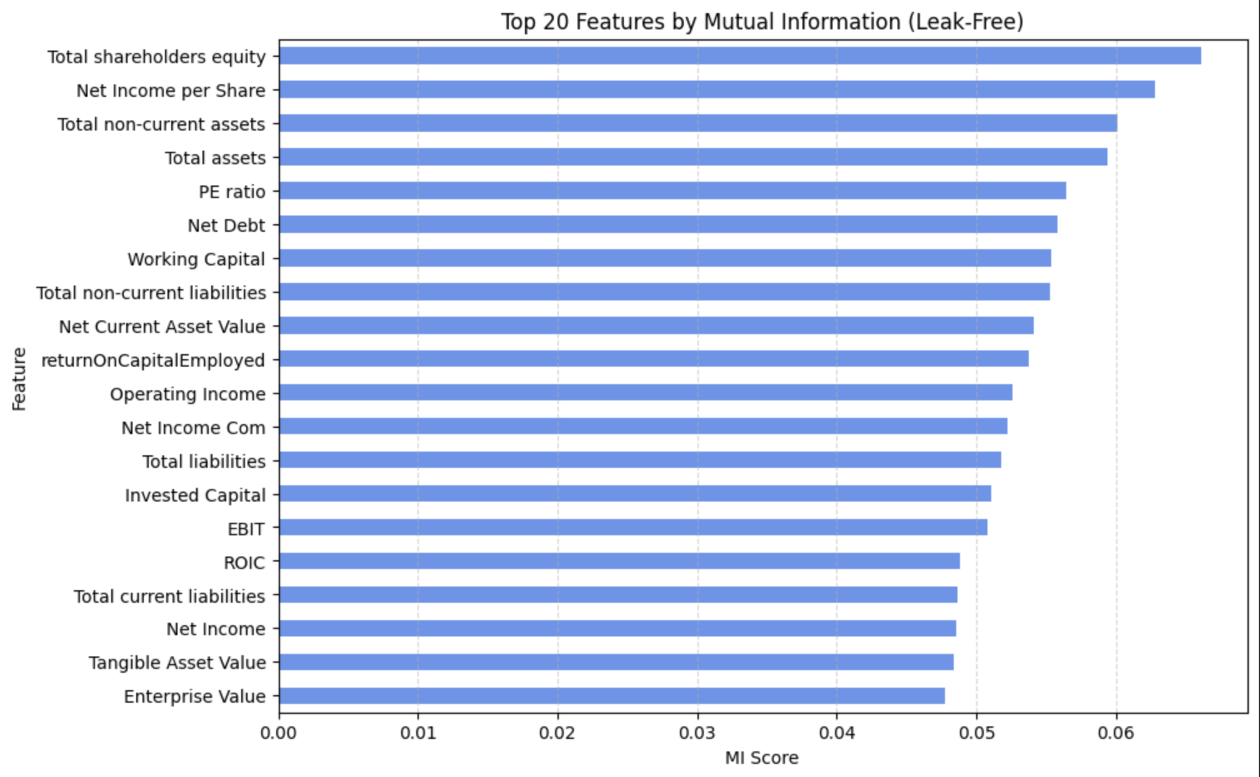
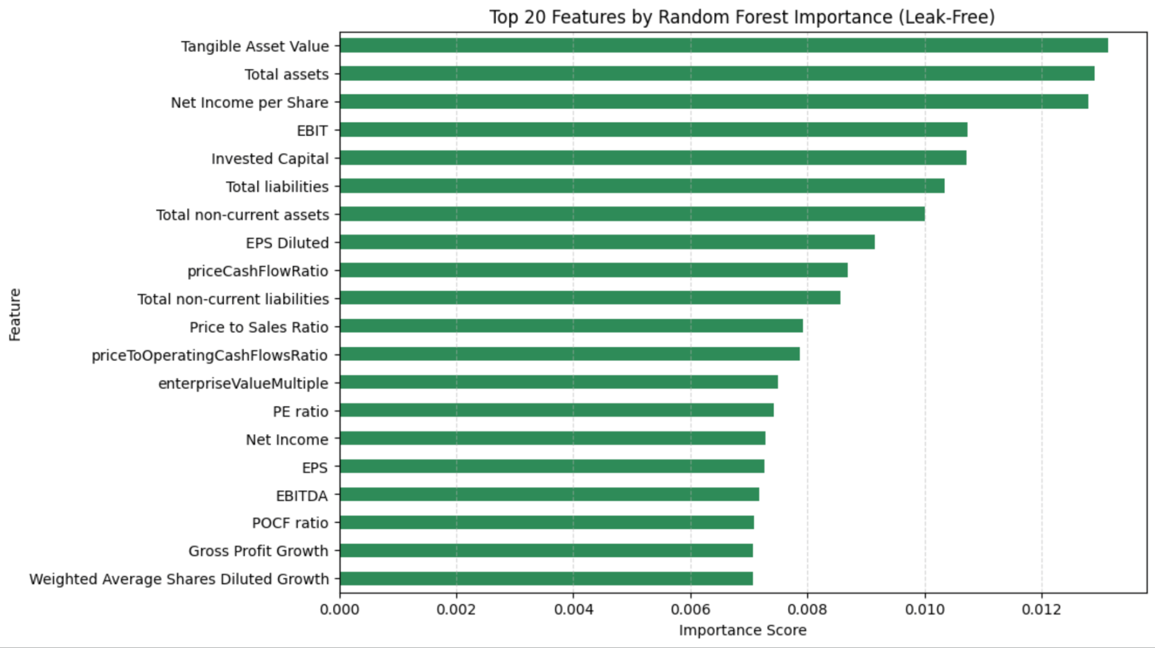
Feature Selection 3
Three methods:
Mutual Information
Random Forest
LASSO Regression

Slide 13
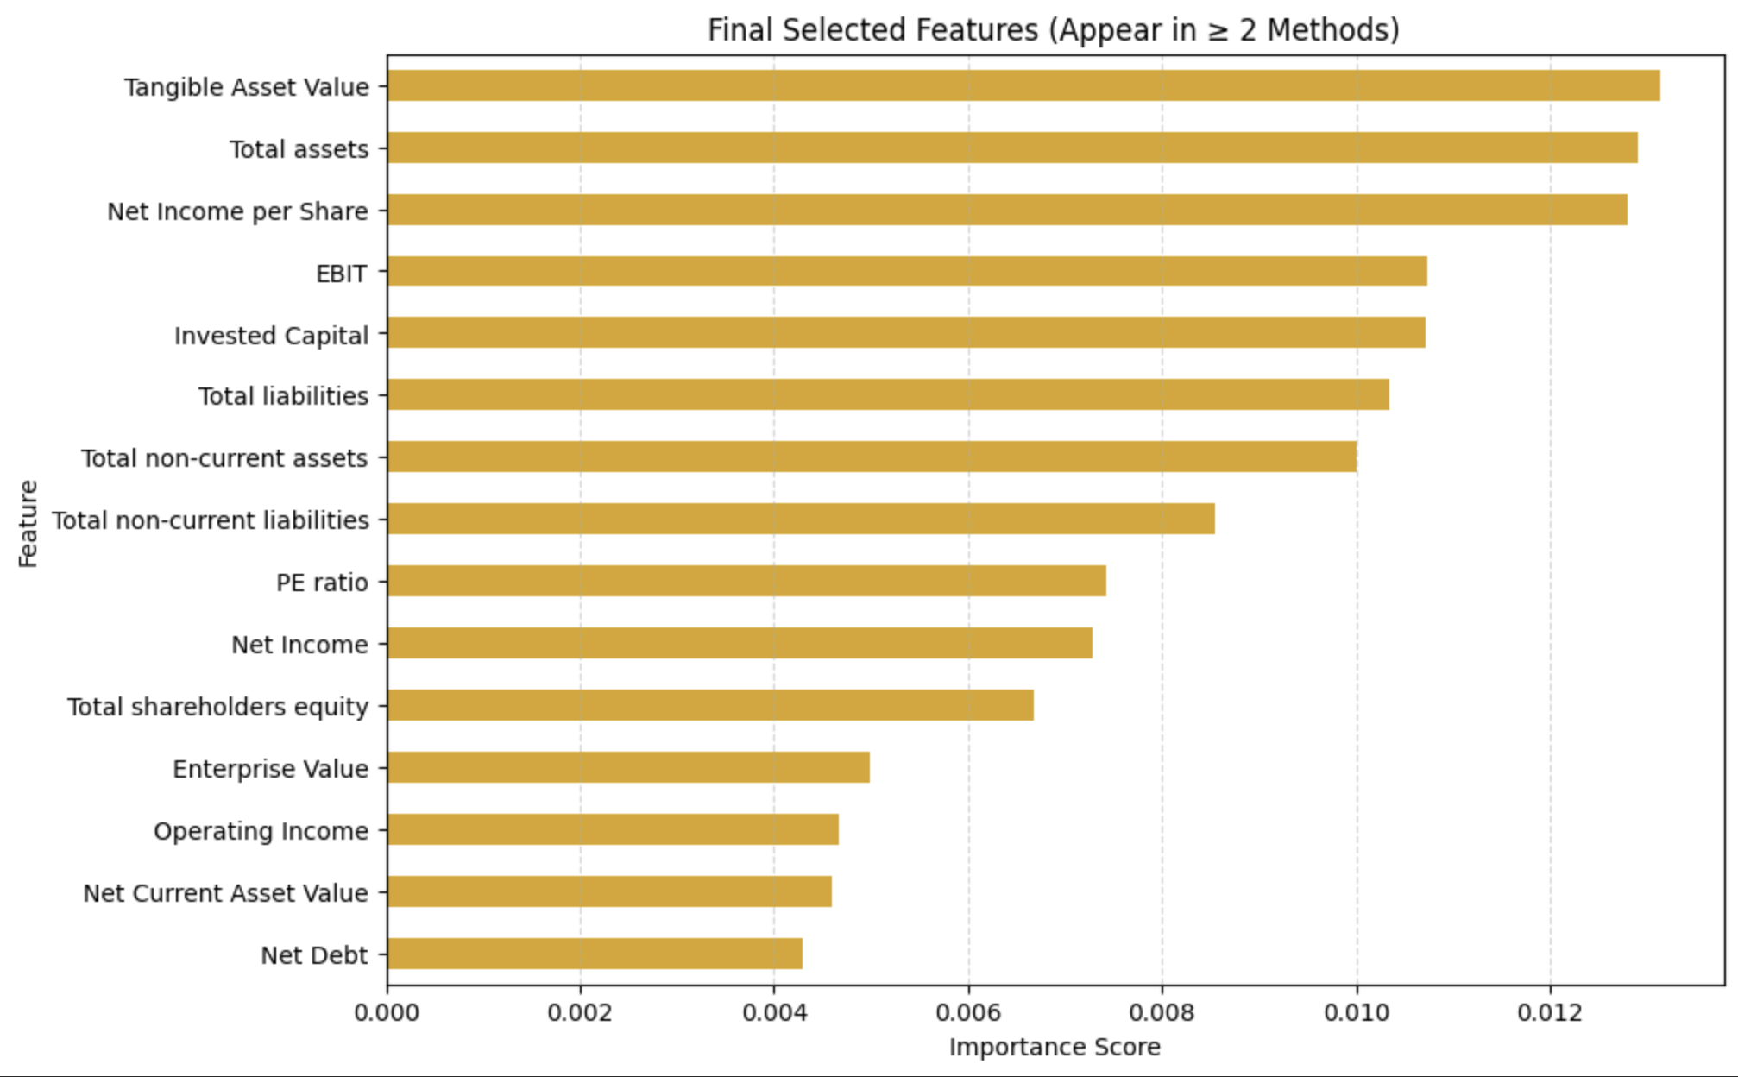
Feature Selection 3
Criteria: Feature must appear in ≥2 methods Result: 15 features selected

Slide 14
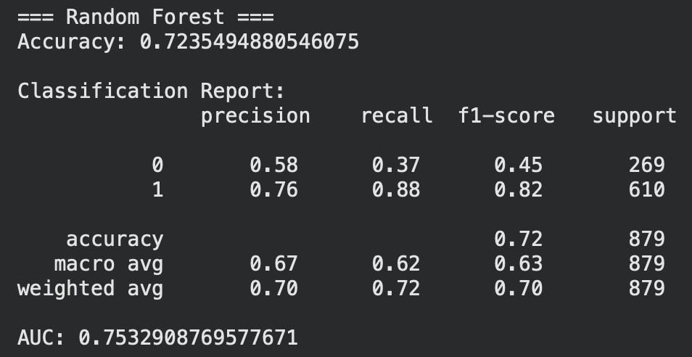
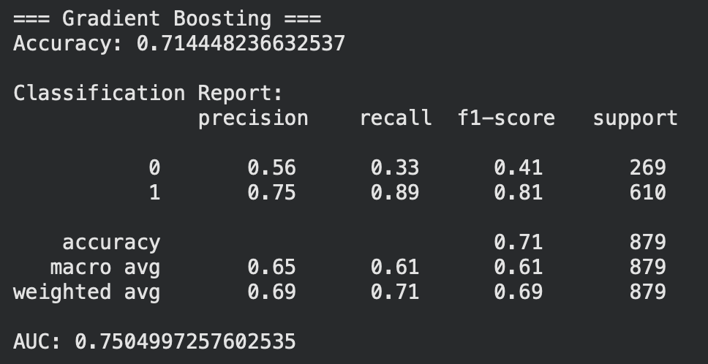
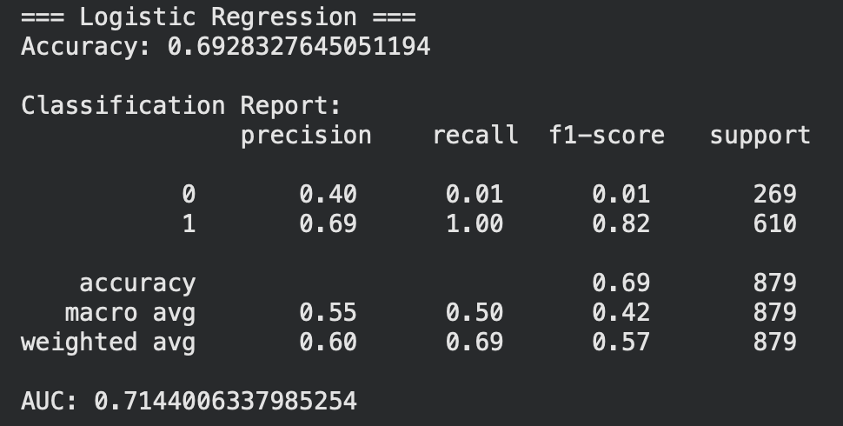
Results
Logistic Regression struggles with class 0 because the dataset is moderately imbalanced (more class 1 stocks).
Random Forest and Gradient Boosting significantly outperform Logistic Regression, showing better ability to capture nonlinear relationships in financial data.
AUC values around 0.75 indicate the models have moderate predictive power, which is expected in real-world stock prediction problems.

Slide 15
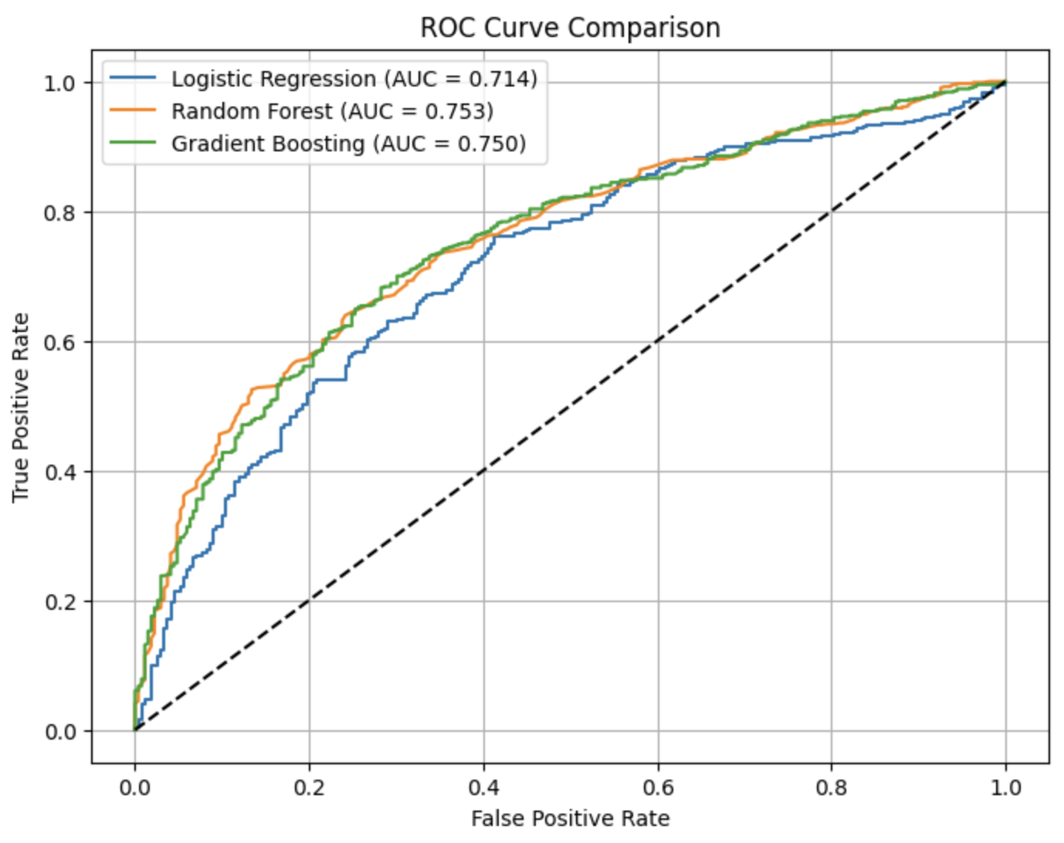
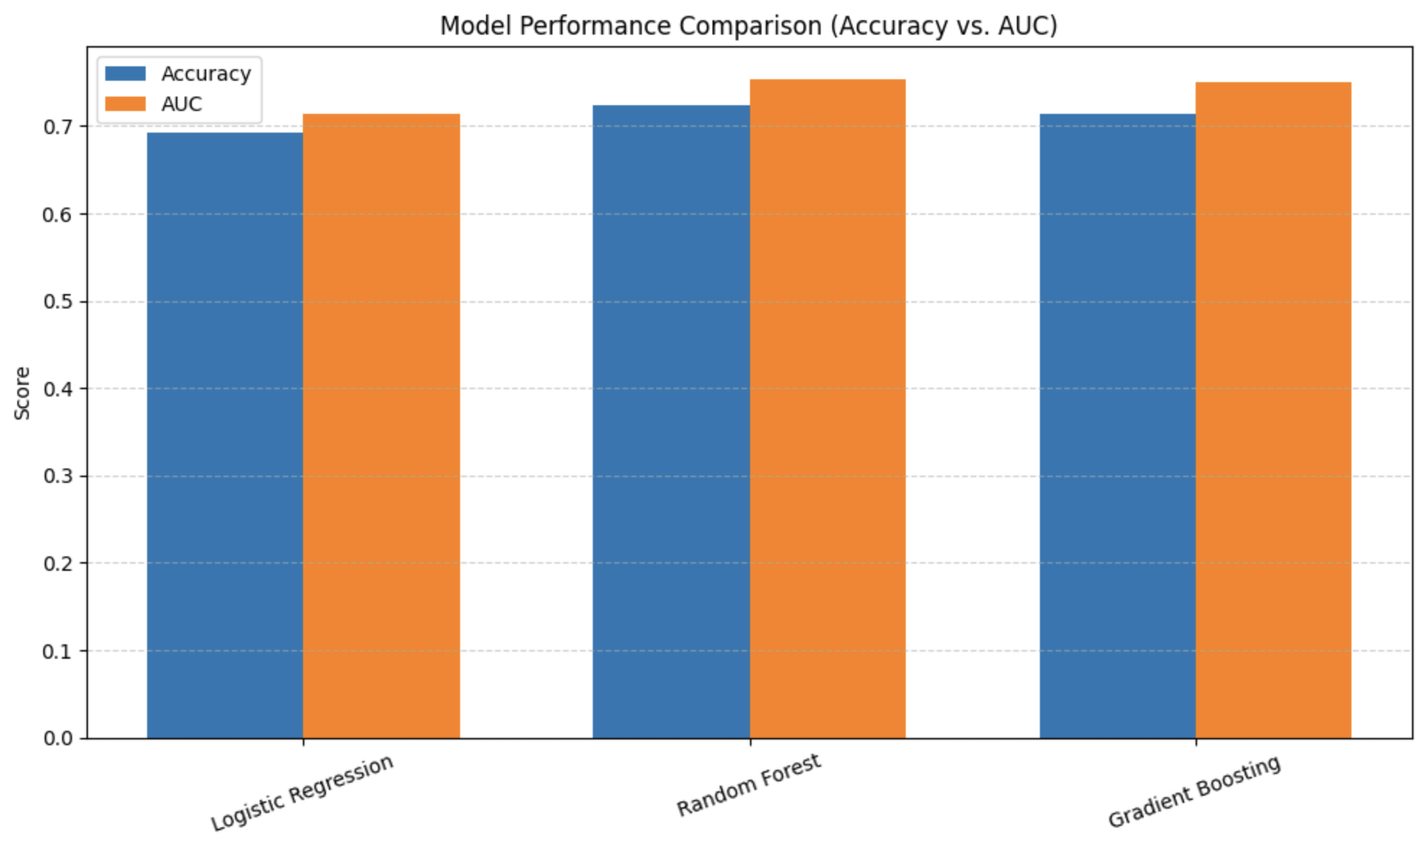
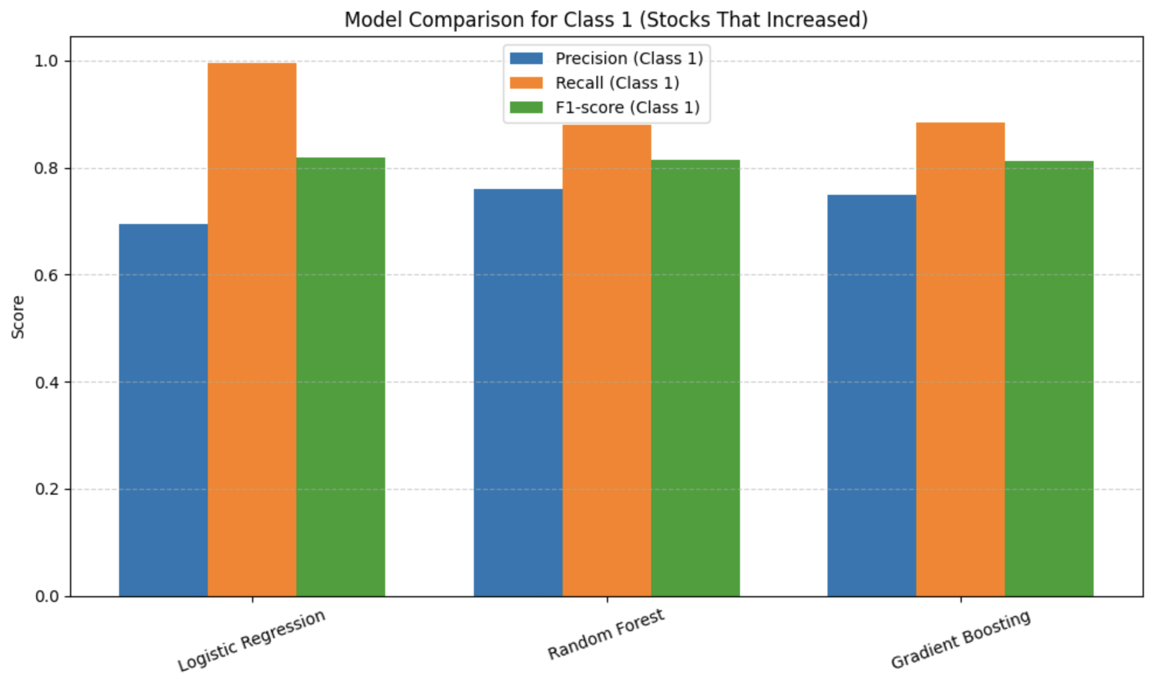
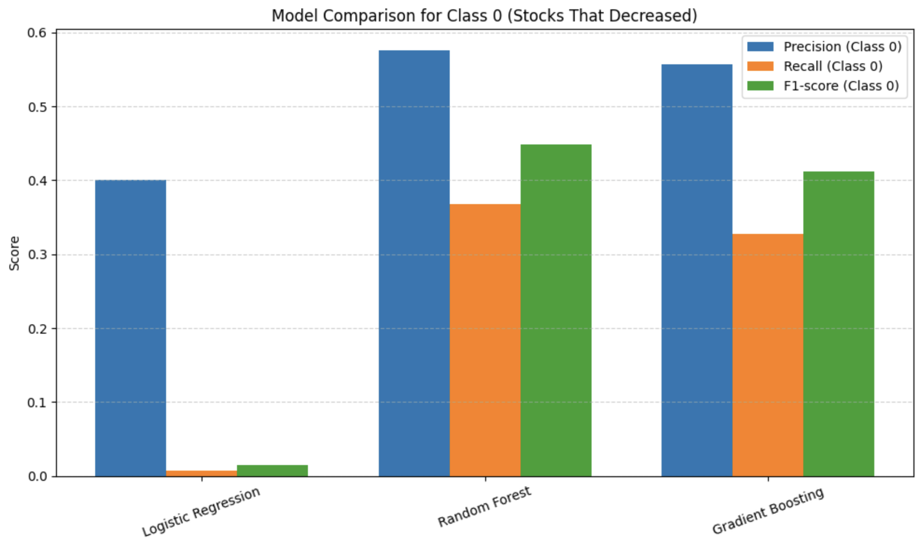

Slide 16
Future Work
Handle class imbalance:
SMOTE, class weights, threshold tuning
Try advanced models:
XGBoost, LightGBM
Add external data:
Market trends, macro indicators
$

Slide 17
Conclusion
What we built: A leak-free stock prediction model using only accounting data
What we learned: Data leakage can hide in plain sight, rigorous validation is critical
What we achieved:
Random Forest: 72.4% accuracy, 0.753 AUC
Realistic, reproducible results
Deep understanding of the methodology
$
$
$

Slide 18
Thank You!
Questions?
$
€
£

